Slide 1
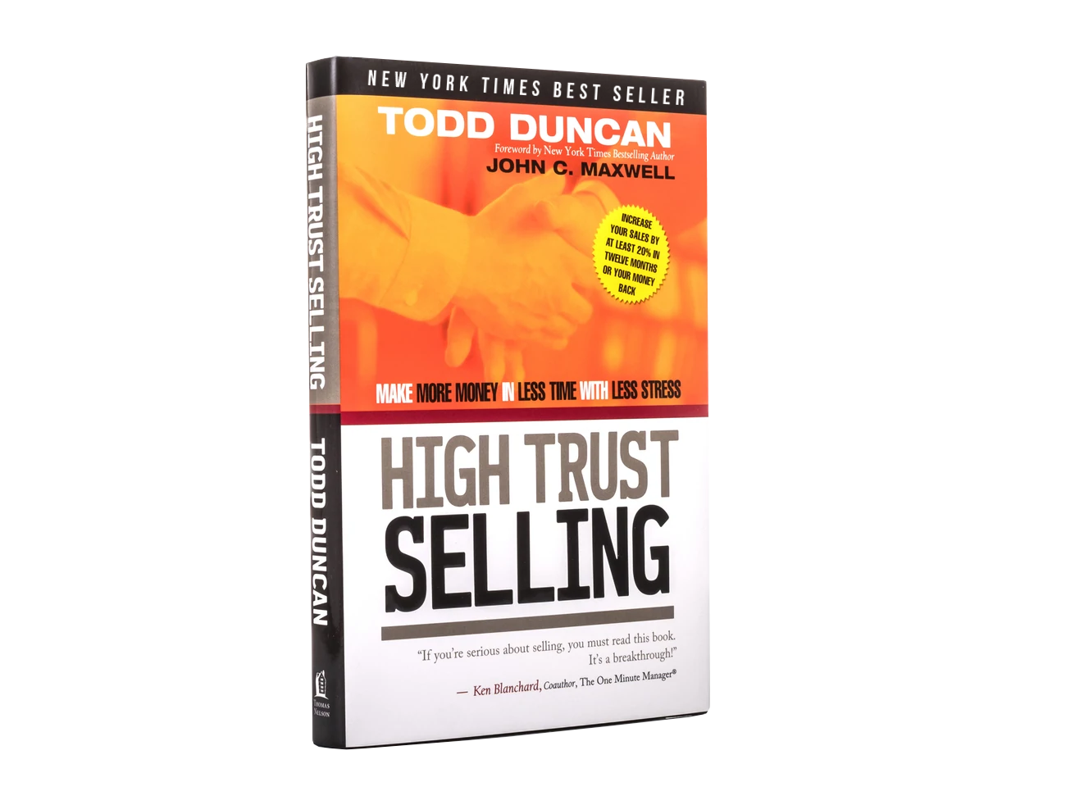

Xcelerate: Close More Loans NOW!

Slide 2
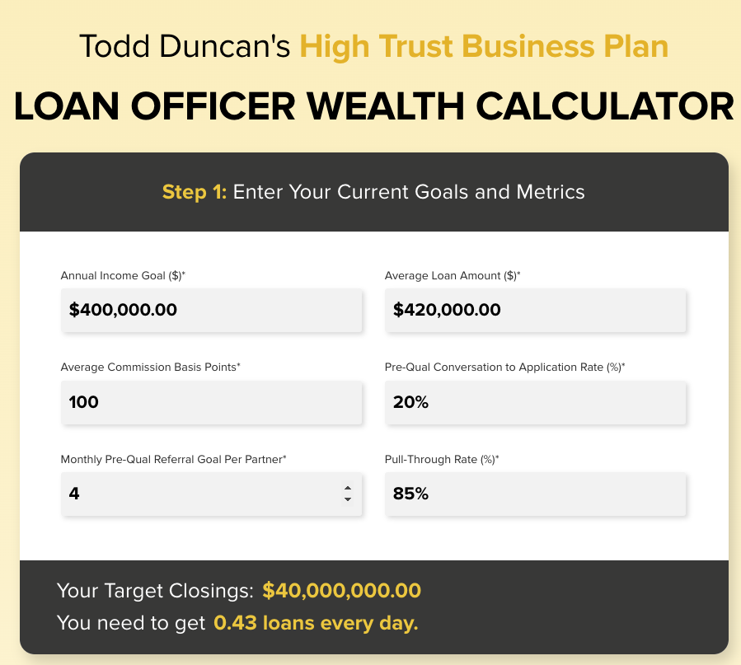
The Economics of the 1% Rule

Slide 3
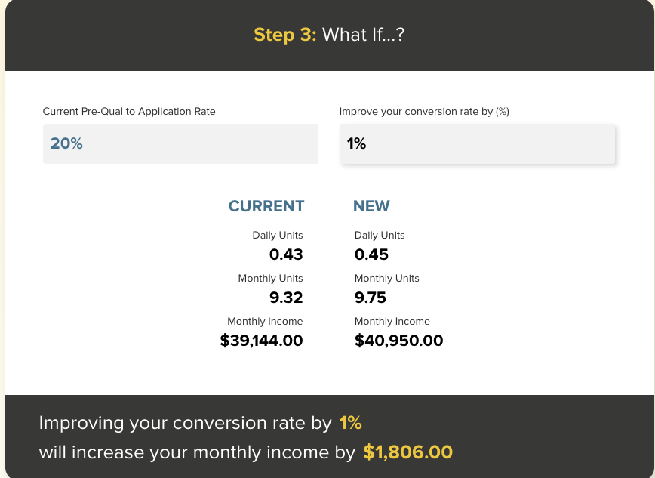
The Economics of the 1% Rule

Slide 4
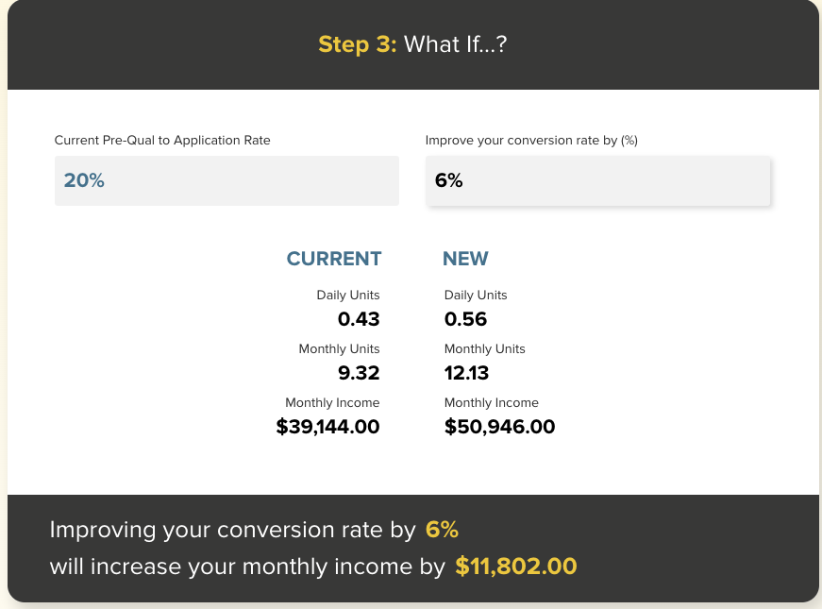
The Economics of the 1% Rule

Slide 5
Law #8:
The Law of the Dress Rehearsal
Practicing your lines elevates your performance

Slide 6
The 3 Pivots
#1: CALL
#2: CONNECT
#3: CONVERT

Slide 7

Pivot #1: CALL
Who do you know?
Who do they know?
Do they know you?
What do you need to know about them?

Slide 8

Pivot #2: CONNECT-Pattern Interrupt
Create professional friction.
Get past interest rates
with borrower immediately.
Ask one ANCHOR question
that locks them in.

Slide 9

Pivot #3: CONVERT – Power Phrase
Definitive promise
Immediate next action
Tie convo to Anchor answer

Slide 10
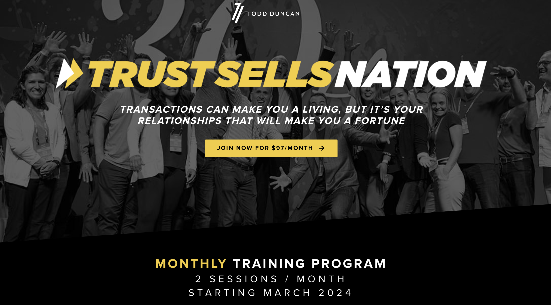


Slide 11
Introducing Trust Sells Nation……..

Slide 12
SAMPLE: CALL
Who do I know who knows who I need to know?
Real Estate Agents
What friends of yours sell real estate and they need a lender partnership like ours?
Friends and Family
Thank you so much for your 5-Star Rating. Could we ask you a favor? Who do you know who might be buying or investing in real estate in the next 12-months we could contact using your name?

Slide 13

SAMPLE: CONNECT-Pattern Interrupt
Most lenders would quote you a rate at the start, but that’s like a doctor giving you a prescription without knowing where it hurts.
We are different. We are Home Loan Strategists. We architect custom home loan solutions and help you manage your mortgage for life…

Slide 14
SAMPLE: CONNECT-Get Past Rates
So, before we talk about interest rates…

Slide 15
SAMPLE: CONNECT-Anchor Question
First Time Homebuyer
What would owning your first home mean to you?
Move Up Buyer
What would owning your next right home mean to you?
Debt Management
What would having financial peace of mind mean to you?
Reverse Mortgage
What would financial security, in retirement mean to you?

Slide 16
SAMPLE: CONVERT- Next Action
I’m going to make that happen for you. Let’s get started.

Slide 17
GAME CHANGING CONVERSION SCRIPTS
There are a lot of ways to get you a competitive rate, product and cost for your home loan, but before we talk about that, what is most important to you about the mortgage you obtain?

Slide 18
15 GAME CHANGING CONVERSION SCRIPTS
#1: Should I reﬁnance my mortgage to a lower payment?
“It might make sense to do that depending on what you’d like to do with the savings each month? If we lowered your payment by $300 per month, what would you use that savings for, and would it get you closer to your financial goals?”

Slide 19
15 GAME CHANGING CONVERSION SCRIPTS
#2: Should I pay down my mortgage faster or shorten my term?
“Let’s see about what that would look like. By what date or age would you like to have your mortgage paid off and have your home free and clear.”

Slide 20
15 GAME CHANGING CONVERSION SCRIPTS
#3: Should I convert an Adjustable to Fixed or Fixed to Adjustable?
“To answer that, let’s take a deeper dive into the loan you have, what you are wanting to accomplish and then I can guide you to make a wise decision.”

Slide 21
15 GAME CHANGING CONVERSION SCRIPTS
#4: Should I use some of the equity and take cash out of the home for any reason and what is the best way to do that?
“Generally speaking, equity sitting in your home is not earning you an optimized ROI. There are more certain investment opportunities with risk balance that if you wanted to have your equity go to work for you, you may wish to consider. It’s always good to have a Mortgage Offset Account so that whenever you want, you can pay off your Mortgage.”

Slide 22
15 GAME CHANGING CONVERSION SCRIPTS
#5: Should I move to a larger home?
“We always want to help our borrowers with their succession planning with real estate. Share with me your motivations behind moving to a large home and we can do an analysis.”

Slide 23
15 GAME CHANGING CONVERSION SCRIPTS
#6: Should I move to a smaller home?
“We always want to help our borrowers with their succession planning with real estate. Share with me your motivations behind moving to a smaller home and we can do an analysis.”

Slide 24
15 GAME CHANGING CONVERSION SCRIPTS
#7: Should I, or can I, stay in my home or should I move out of the area?
“Great question! From where is the motivation coming for that question? Based on what you said, let’s look at the pros and cons and I’ll make a few recommendations.”

Slide 25
15 GAME CHANGING CONVERSION SCRIPTS
#8: If I move, should I sell or rent out my current home?
“That’s a great question. We would need to take a look at your current assets and cash necessary for the next house, and then calculate the advantages of turning your current home into a rental. There are tax advantages and long-term equity and cash flow benefits if you were to keep it.”

Slide 26
15 GAME CHANGING CONVERSION SCRIPTS
#9: Should I buy a second home or vacation home for our family? Should I rent it out?
“Great question. I have done that several times and it can be both a memory maker, a great investment, and provide certain tax benefits. What prompted this question and where are you now in the decision-making process?”

Slide 27
15 GAME CHANGING CONVERSION SCRIPTS
#10: Should I buy an investment property and how will that help me short and long term?
“Investing in income producing assets to provide residual income is a smart strategy for financial freedom. Additionally, there can be significant tax advantages too. What were you thinking?”

Slide 28
15 GAME CHANGING CONVERSION SCRIPTS
#11: How do I use my equity to start buying rental properties to help me build. residual cash ﬂow?
“Investing in income producing assets to provide residual income is a smart strategy for financial freedom. Additionally, there can be significant tax advantages too. Let’s look at your home’s value, the amount of equity you have, when you want to be financially free, and then we can create a strategy that makes sense.”

Slide 29
15 GAME CHANGING CONVERSION SCRIPTS
#12: Do I have too much money invested in Real Estate or not enough money in real estate?
“This question has more to do with your expertise and desired end-result. How much residual income are you earning, what would you like that amount to be in retirement, and how much do you have to invest? Once we know that, we can put a game plan together.”

Slide 30
15 GAME CHANGING CONVERSION SCRIPTS
#13: Should I, or can I, do a Reverse Mortgage?
“Good questions. What would greater financial security in retirement mean to you? Do you want to thrive or only survive your golden years? Using a reverse mortgage can unlock greater opportunities for more security and additional cash flow. It can also help you right size into a home that better fits your lifestyle.”

Slide 31
15 GAME CHANGING CONVERSION SCRIPTS
#14: Should my parents have a Reverse Mortgage?
“What would stronger financial security for your parents mean to you? Using a reverse mortgage can allow your parents to increase cash flow, without the obligation to pay principal or interest payments. This can help with covering necessary life expenses and making more memories!”

Slide 32
15 GAME CHANGING CONVERSION SCRIPTS
#15: What should I do with an inheritance of money or real estate?
“Great question. The easy answer is to save it while simultaneously putting it to work for you. There are many ways to do that and as I’m not a Financial Planner, I can link you up with my partner who is, and we can talk through your goals and decide the best way for you to go?”

Slide 34
Introducing Trust Sells Nation……..

